Slide 1
Revv52 Brand Toolkit
Guidance on how to best express Revv52 to our fans
Notes:
Revision History
First draft shared with the Revv52 Marketing committee on November 28, 2022

Slide 2
Giving people a deeper understanding of Revv52
A brand is experiential.
It’s what people think of when Revv52 is seen or mentioned.
Our brand is the perception people have about what we do and how we do it.
The Revv52 mission, vision and values are expressed in our brand

Slide 3
Revv52 Mission and Vision
Mission (DRAFT)
Revv52 unites exceptional voices in fearless pursuit of innovative vocal artistry to deliver electrifying performances that energize audiences.
Vision
Canada's leader in innovative vocal arts

Slide 4
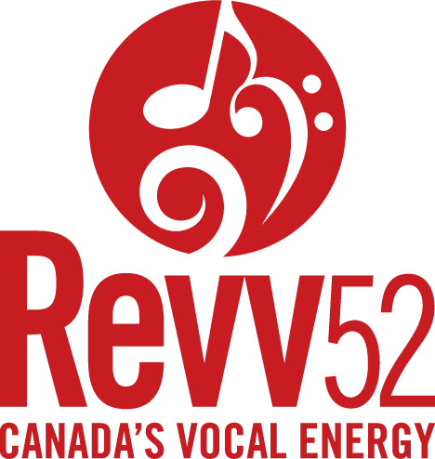
Revv52 Core Values
We are artistically agile
Our brand is widely recognized
We are mindful of our Revv52 family
As a group we value creativity, diversity, excellence, collaboration and community.
We understand the evolving landscape
We cherish our sense of fun
The audience experience is dazzling
Our structure is sustainable

Slide 5
Revv52 Strategic Goals and Initiatives
Increasing diversification and discovery
Internal and external diversification
Increased collaboration with different cultural communities
Have a diversity and inclusion committee
Enhancing collaboration and relationships
Form a relationship team
Actively seek out relationships
Inter-group collaboration
Member development
Enhance vocal coaching
Introduce workshops and master classes
Enhance communication and connection
The following strategic initiatives were developed as part of the 2022 Strategic Planning Sessions
Note - there is a new Strategic Plan in the process of being finalized

Slide 6
Revv52 Logo, Font, colours and voice
Creating consistency where we can with our Internet presence.

Slide 7
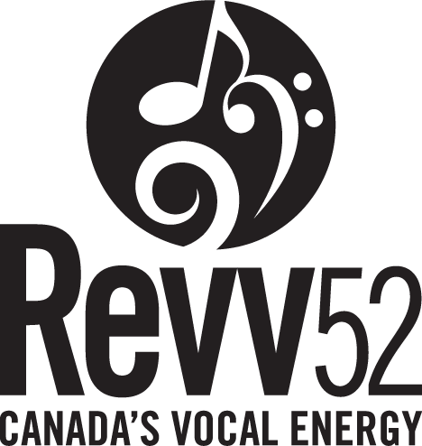
Logo usage guidelines
Default logo colour is solid black
A minimum clearance measuring half the height of the logo’s lower case letters is recommended
The tagline “Canada’s Vocal Energy” should be included whenever possible
Omit the tagline if the logo is smaller than 1” wide

Slide 8
Revv52 Brand Voice
Words to describe Revv52
Inspiring | Energized | Entertaining
Professional | Fun | Calgary
Singers | Performers | Popular Music

Slide 9
Revv52 Fonts
Lato Normal
Revv52 (shrinking numbers) - used within text to avoid line spacing issues
Revv52 (enlarging letters) - should only be done at the beginning of a paragraph or in a title.
The Revv52 logo was created using the Trade Gothic Bold font available through Adobe where we want to align text with the logo specifically.
Using Google Fonts for open-source Truetype Fonts Pathway Gothic One

Slide 10

Revv52 Colour Palette
The colour palette for each Revv show can change quite dramatically (see 70th Anniversary posters on the right). Because of that, the standard Revv52 colour palette is black and white with shades of grey with an accent red that matches our logo
R:245
G:245
B:245
#F0F0F0
R:220
G:220
B:220
Hex:#DCDCDC
R:120
G:120
B:120
Hex: #787878
R:40
G:40
B:40
Hex: #282828
R:199
G:29
B:34
Hex: #C71D22

Slide 11






Revv52 Brand on the Internet

Slide 12
Revv52 Social Media Image Sizes
 | Instagram | Facebook | X | LinkedIn | TikTok
Profile photo | 320 x 320 | 170 x 170 | 400 x 400 | 400 x 400 | 200 x 200
Landscape | 1080 x 556 | 1200 x 630 | 1024 x 512 | 1200 x 627 | 1920 x 1080
Portrait | 1080 x 1350 | 630 x 1200 | 1080 x 1350 | 627 x 1200 | 1080 x 1920
Square | 1080 x 1080 | 1200 x 1200 | 1080 x 1080 | 1080 x 1080 | 1080 x 1080
Stories | 1080 x 1920 | 1080 x 1920 | N/A | N/A | 1080 x 1920
Cover Photo | N/A | 851 x 315 | 1500 x 1500 | 1128 x 191 | N/A

Slide 13
Revv52 Social Media Image Sizes
Square (1:1) - works for most posts
Landscape (16:9) - Max 1,920 x 1,080
Portrait (9:16) - Max 1,080 x 1,920
FB Banner - 1,200 x 628
YT Banner - 1,280 x 1,152

Slide 14
Image Sizes
Profile Photo - 170 x 170
Cover Photo - 1200 x 628
Use of Logo
Watermark on photos where they are Revv pictures
Tags
Links
Facebook is changing from a branding perspective as they make changes to mirror other social media channels. Need to stay on top of changes.

Slide 15
Image Sizes
Profile Picture - 320 x 320
Post images - 1,080 wide with height as follows
Square (1:1) - 1,080 (preferred)
Portrait (4:5) - 1,350
Landscape (1.91:1) - 566
Use of Logo
Watermark on photos where possible
Content
Images - Mirrors the FB posts
Videos - usually 20-30 second clips.
Stories -
Tags
With Instagram being a part of Meta, there is much overlap with Facebook. Instagram is oriented more to images and videos - especially with Instagram Television (IGTV).

Slide 16
Image Sizes
Profile Photo - 800 x 800 px
Banners - 2,048 x 1,152 px
Video thumbnail - 1,280 x 720 resolution using 16:9 aspect ratio. Needs to be less than 2MB
Use of Logo
Logo on video. Usually white stacked logo bottom right. Size = 1,280 x 720 (16:9 ratio)
Fonts
We want to stay consistent between videos within a playlist.
Tags
Default tags -
Youtube is the primary channel for the Revv52 to be seen outside of in person performances. Largely videos, but may need to work on consistency for video thumbnails.

Slide 17
Image Sizes
Home Page - A group image of as much of the cast as possible. Usually from the prior show. 2,000 x 900 and less than 800kb
Upcoming Shows - 2,000 x 480 for the banner and square for the page
Member Photos - prefer square, but can be rectangular
Use of logo, colour palette, etc.
The Revv52 website is where most of the brand elements for the internet are combined into one.

